Slide 1
Classification Model Project for Customer Churn Prediction
A Comparative Analysis of Logistic Regression and Decision Tree Models
Presenter’s Name: ODHIAMBO APIYO Date: 1ST September 2024

Slide 2
Overview
This analysis is based on churning of customers based Syria Telecommunications company.
We will use machine learning techniques to analyze telecommunications data and customer behavior patterns, with the goal of deriving actionable insights, enhancing service quality and majorly customer retention.

Slide 3
Introduction
Business understanding
In the telecommunications industry, churn is a significant concern as it directly impacts revenue and market share.
The primary goal of churn analysis is to understand the factors that lead customers to switch to competitors or discontinue service altogether.
By identifying patterns and behaviors that precede customer churn, companies can develop proactive strategies to enhance customer retention, improve customer satisfaction, and maintain a stable revenue stream

Slide 4
Objective: The primary goal for this project was to develop a model that predicts customer churn and identifies key features contributing to churn. Understanding these features helps the company proactively address potential churn and improve customer retention strategies.
Data Source: The data used was from telecom customer churn dataset containing customer demographic and usage data, including details like call minutes, charges, and service calls.

Slide 5
Data Preparation
Data Encoding: Categorical features, such as the 'International Plan', were encoded to numerical values to ensure compatibility with the models.
Feature Scaling: I applied feature scaling using StandardScaler, which standardizes features by removing the mean and scaling to unit variance. This step is crucial for algorithms like Logistic Regression that are sensitive to feature scales.
Train-Test Split: To evaluate our models effectively, we split the dataset into 80% for training and 20% for testing. This allows us to train the model on one subset and evaluate its performance on unseen data.

Slide 6
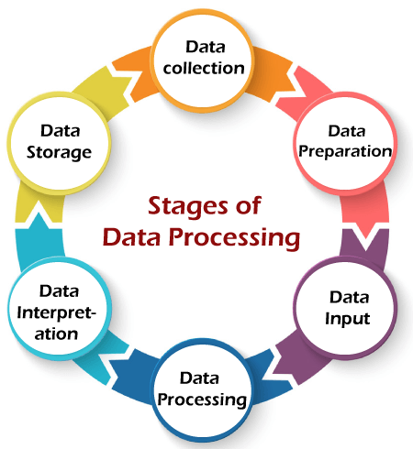

Slide 7
Data Exploration
The columns in the data set had no missing columns and this indicated that we were dealing with a clean dataset.
The columns were divided into two;
Numerical columns,
Categorical columns.

Slide 8
Feature Distribution
Numerical features;
The majority of the feature distribution of the numerical columns had a normal distribution. This showed that the data set had an even distribution with a small percentage of outliers
Categorical Features
More customers without a voicemail plan have churned: There is a higher frequency of churn among customers without a voicemail plan (labeled as "no" on the x-axis) compared to those with a voicemail plan (labeled as "yes" on the x-axis).

Slide 9
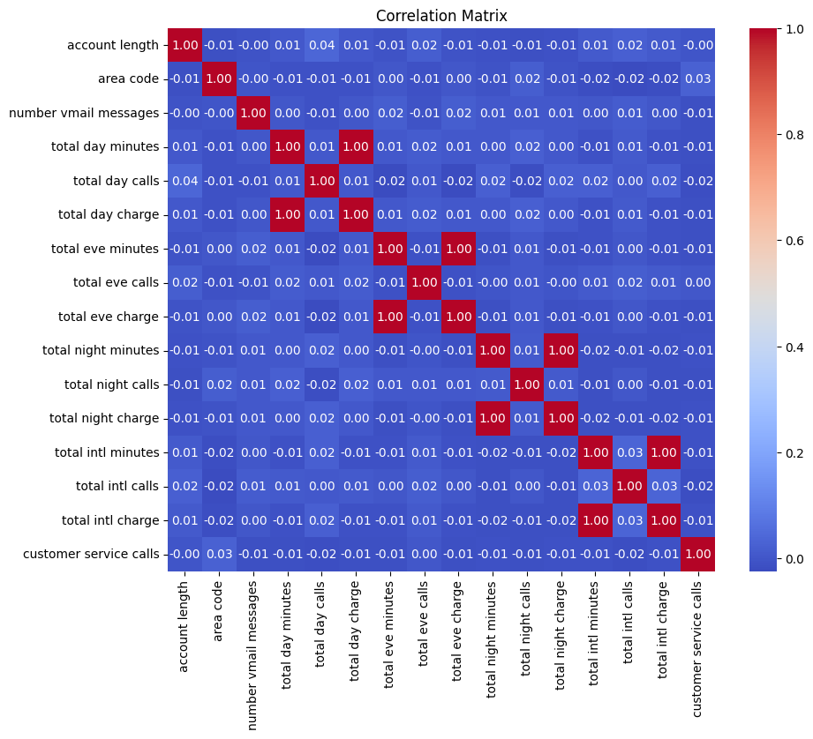

Slide 10
Correlation matrix for Numeric features
The correlation matrix provides insights into how each feature relates to one another, which can help us identify patterns and dependencies in our data.
Features with high correlation.
total day minutes and total day charge have a correlation of 0.9999999521904007
total eve minutes and total eve charge have a correlation of 0.9999997760198491
total night minutes and total night charge have a correlation of 0.9999992148758795
total intl minutes and total intl charge have a correlation of 0.9999927417510314
day minutes and total day charge have a correlation of 0.9999999521904007l day minutes and total day charge have a correlation of 0.9999999521904007

Slide 11
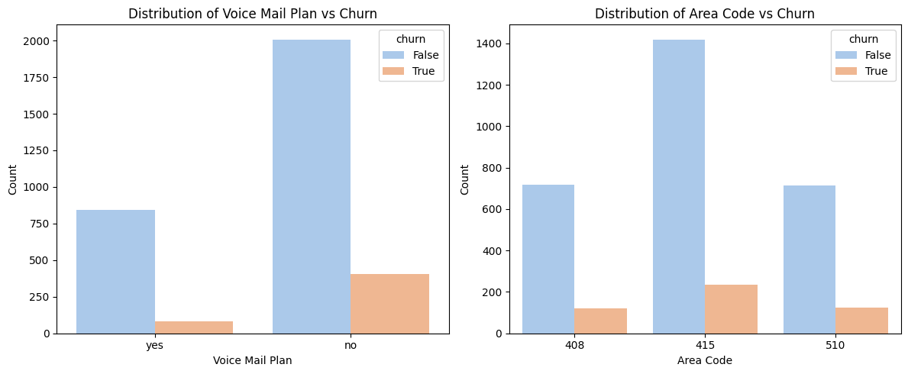

Slide 12
Detecting Outliers
Impacts of Outliers in Classification Models
Model Performance: Outliers can distort the decision boundary in classification models, leading to less accurate predictions. Models might become too sensitive to these outliers, affecting the overall performance
Bias and Variance: Outliers can increase the variance of the model, leading to overfitting. This can make the model too complex and less generalizable to new data.
Feature Importance: Outliers can affect the importance of features, potentially leading to misleading insights about which features are most relevant for classification.
Number of outliers removed: 164

Slide 13
MODELLING
The two main models used were:
Logistics model
Decision trees.

Slide 14
Logistic Regression Model
Model Overview: Logistic Regression is a simple linear model used for binary classification. It predicts the probability of a customer churning based on the weighted combination of input features.

Slide 15
Performance of the logistic regression model.
Training Accuracy: The model achieved an accuracy of 86.59% on the training set.
Test Accuracy: The model’s accuracy on the test set was 84.85%, indicating decent generalization to new data.
AUC (Test): An Area Under the Curve (AUC) score of 0.79 suggests moderate capability in distinguishing between churn and non-churn cases.
Key Observations: The model has a low recall for predicting churn, which means it may miss identifying some customers who are likely to churn.

